Slide 1
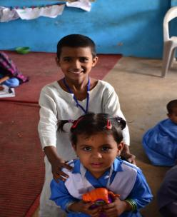

ISSUES OF ACCESS AND LEARNING IN EARLY CHILDHOOD EDUCATION: EMERGING TRENDS & CHALLENGES FROM ASER PAKISTAN
SAHAR SAEED
Program Manager ASER
Right to Education & Early Childhood Education & Development
17th September, 2014

Slide 2
Presentation Overview
Background
Data Trends (ASER Pakistan) – Access & Learning
ECE Programmes (By ITA)
Action & Implementation

Slide 3
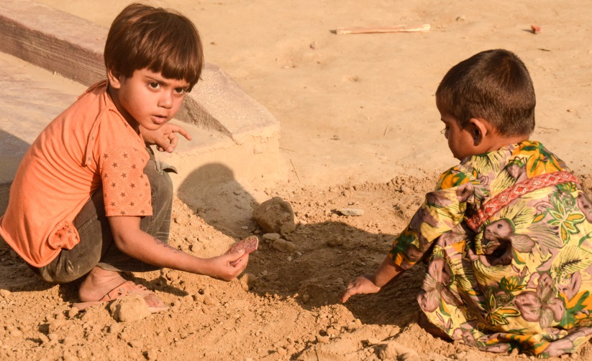
BACKGROUND

Slide 4
Children waiting to be the centre of attention!!!
Affected due to many reasons including poverty, vulnerability, lack of resources.
A chronic lack of inter-departmental collaboration for challenges of health, nutrition, care/protection & learning.

Slide 5
GMR (2013-2014)
Poor levels of learning (at lower grades)
of primary school resulting in millions of
children leaving education before acquiring
basic skills.
The linguistic, cognitive and social skills
that children develop in early childhood
are the foundations for lifelong learning.
Studies from many countries, including Chile, India and
Madagascar, show the contribution of pre-school to
overall cognitive abilities.

Slide 6
ECE: What is promised?
(National Education Policy -NEP 2009 & Article 25 A – Right to Education –for 5-16 years )
At least one year pre-primary education to be provided by the State.
Universal access to ECE shall be ensured within the next ten years.
Provision of financial and food support to children who drop out because of poverty at ECE
Two year pre-service training to ECE teachers.
Recognition and strengthening of Katchi class as part of formal system.

Slide 7
ECE in Pakistan: What we have…
National Curriculum 2007 aligned with developmental domains
  Contextualized, consultative and research based
Frameworks for classroom implementation in rural and urban areas for ECE
Early Learning Development Standards (ELDS) – validation still not done
Specific policies for ECE introduction, budgetary provisions and plans across Pakistan:
  Sindh Sector Plan
  Balochistan Sector Plan
  Punjab ECE Sector Plan
  KP Sector Plan
  RTE Acts in ICT, Sindh and Ordinance in Balochistan
A robust mix of technical and grassroots expertise for Teacher Education, best practices; innovations follow-up and support

Slide 8
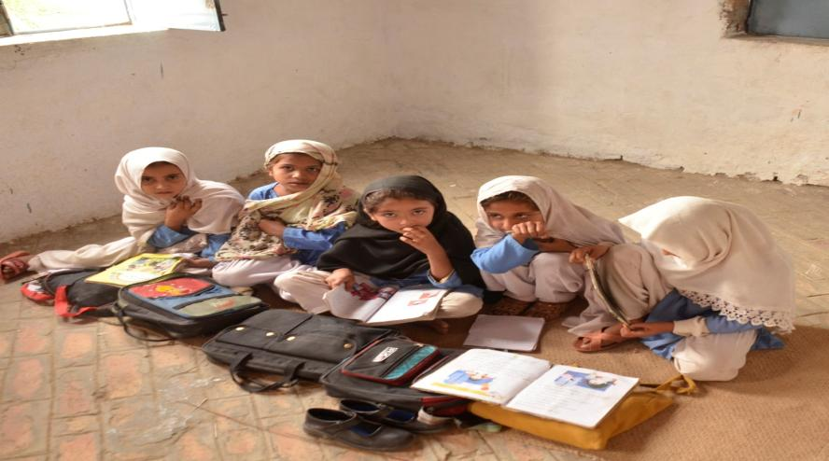
DATA TRENDS (ASER PAKISTAN)

Slide 9
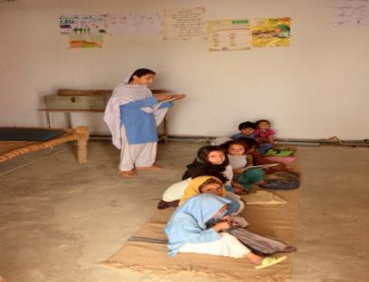
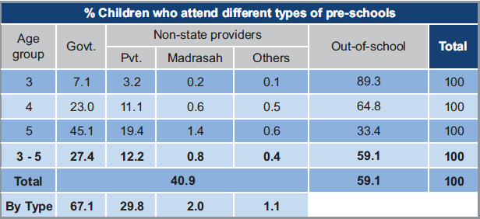
Pre-School Enrollment (3-5 Years) – ASER (Rural)
Enrollment of children: 3 – 5 years = 41% in 2013 -Rural
ECE in Public Sector: 67 %.
ECE in Private Sector 33%

Slide 10
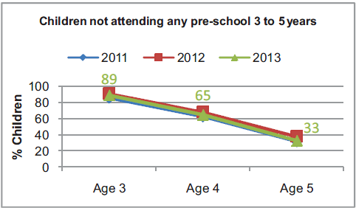
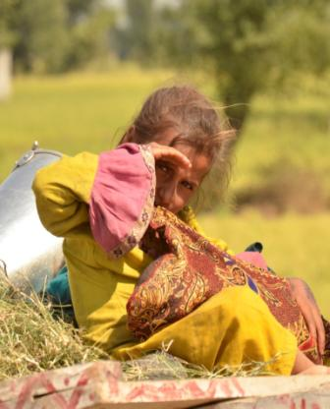
Children not attending any Pre-School 3 to 5 yrs
Out of school children (3 years):
89% in 2013.
Out of school children (4 years):
65% in 2013.

Slide 11
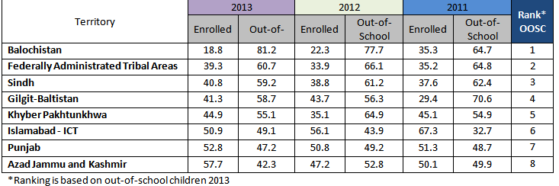
Region Wise Enrollment Trends (3-5 Years)

Slide 12
Evidence of Readiness of Children
Transiting from Pre School to Primary (ASER NATIONAL-RURAL)

Slide 13
Evidence of Readiness of Children
Transiting from Pre School to Primary (ASER NATIONAL-RURAL)

Slide 14
Evidence of Readiness of Children
Transiting from Pre School to Primary (ASER NATIONAL-RURAL)

Slide 15
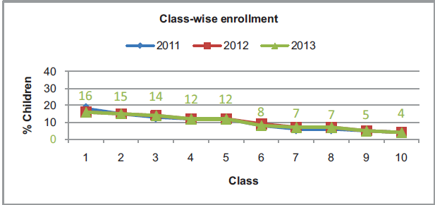
Poor Readiness leading to HIGHER DROP OUTS!!!
Enrollment decreases as class level increases
One third children are lost after primary schooling due to learning & facility gaps

Slide 16
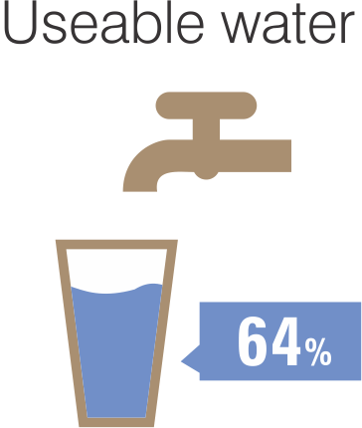
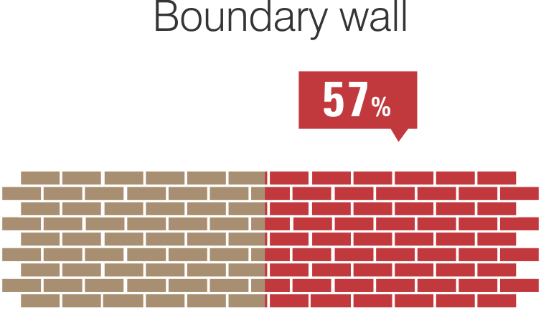
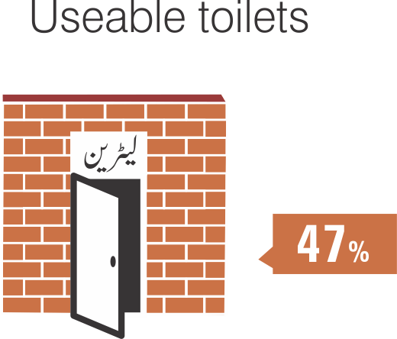
Basic Facilities
GOVERNMENT PRIMARY SCHOOL
(RURAL)
Basic facilities in schools are still missing: only 64% government primary schools have drinkable water facility, 57% have complete boundary walls and 47% have usable toilets.

Slide 17
Points to Ponder:
Although much stress is on enrolment, the real question is whether the schools are ready to induct young children and provide them with a thriving, curious and positive nurturing learning environment?
Do the schools have sufficient learning resource material to make the experience meaningful?
Do the teachers’ realize the significance of ECE and do they see themselves as quality caregivers?
Q: Are there teachers available and trained to facilitate a batch of 30-50 -90 children?

Slide 18
Marching towards 2015: What we need to do
Pay heed to research & start implementing policies!
Move from ECE to ECCE! (0-8 years)
End the randomness – use of terms, introduction of textbooks, lesson plans, formulas, investment of & on resources
Connect – research & policy, school & community, numeracy/literacy with cognition & development
To turn attention to the role of teachers in early grades and the contributions made by pre-service and in-service training.

Slide 19
Marching towards 2015: What we need to do
Without an investment and resource strategy for quality, children will continue to suffer from social, emotional and learning stress….especially the bottom ones.
Emergent health and education collaboration must be strengthened for institutional ownership and the beginning of an ECCE program in Pakistan.
Need for a multi-sectoral stakeholders group to formulate ECD/ECCE national strategy document with provincial ownership.
Post 2015 – ideally a stand alone goal for ECE (Arnic, ECCE Consultative group)

Slide 20
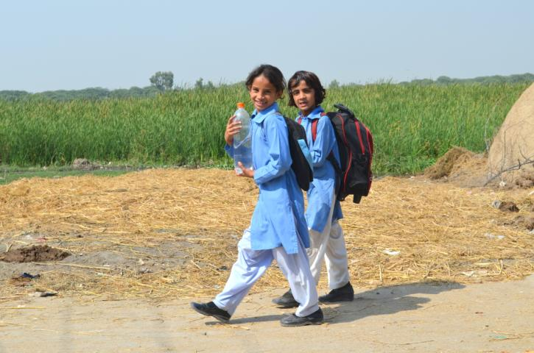
THANK YOU!

